Slide 1





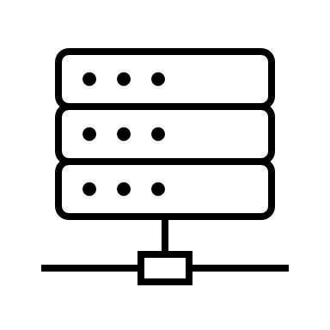







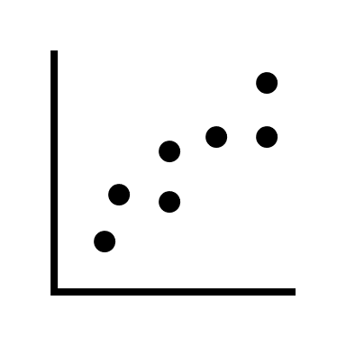



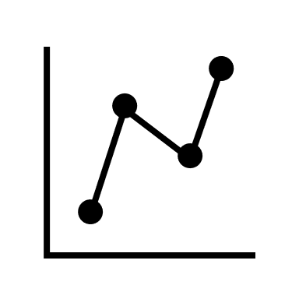


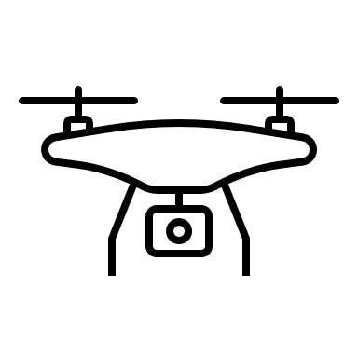






Edge Devices
Edge Servers
Regional Edge
Enterprise Cloud
Cloud
Hundreds
Thousands
Millions
Billions
Figure 2.2 – Edge computing at scale

Slide 2









DataFlow
Realtime
1 – 3 ms
5 – 10 ms
30 – 50+ ms
Cloud
E
V
E
N
T
B
A
C
K
B
O
N
E
Collect
Store
Edge Inference Server
Cleanse
Train / Retrain
Organize
Analyze
Figure 2.3 – A representative data flow in edge computing

Slide 3
AD
Decision Points in an Edge
Architecture
Device
Network
Cluster
Cloud
Figure 2.4 – The four decision points affecting edge architecture

Slide 4
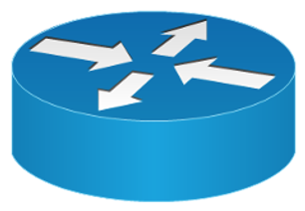
NSEW
Cloud
Cloud
Datacenter A
Datacenter B
North-South
East-West
Figure 2.5 – Network traffic flow

